Slide 1
Human Body Systems Review

Slide 2
Let’s Review
You are groups of 4,
Go to each stations scenario,
Identify the systems
Explain the Interaction
Must include at least 8 systems in each explaination
Be prepared to share your information with the class
You won’t know which one is your Station so make sure you are thorough

Slide 3
I Do - We Do - You Do
You are groups of 4,
Go to each stations scenario,
Identify the systems
Explain the Interaction
Must include at least 8 systems in each explanation
Be prepared to share your information with the class
You won’t know which one is your Station so make sure you are thorough
Brooke is running down the hall, Ms. Welsh sees her and asks for her Eagle card. Brooke tries to explain she was in a hurry to check out, her mom is in the office. Which systems are INTERACTING HERE?

Slide 4
I Do - We Do - You Do
You are groups of 4,
Go to each stations scenario,
Identify the systems
Explain the Interaction
Must include at least 8 systems in each explanation
Be prepared to share your information with the class
You won’t know which one is your Station so make sure you are thorough
Hudson was nominated for student of the month, he is required to make a speech at the Cobb County Board meeting. He has been working on this speech for a week and has most of it memorized. He has been so excited that he hasn’t eaten lunch today and his stomach has begun to rumble. He doesn’t have time to eat and he can’t find the note cards with his speech. Which systems are INTERACTING HERE?

Slide 5
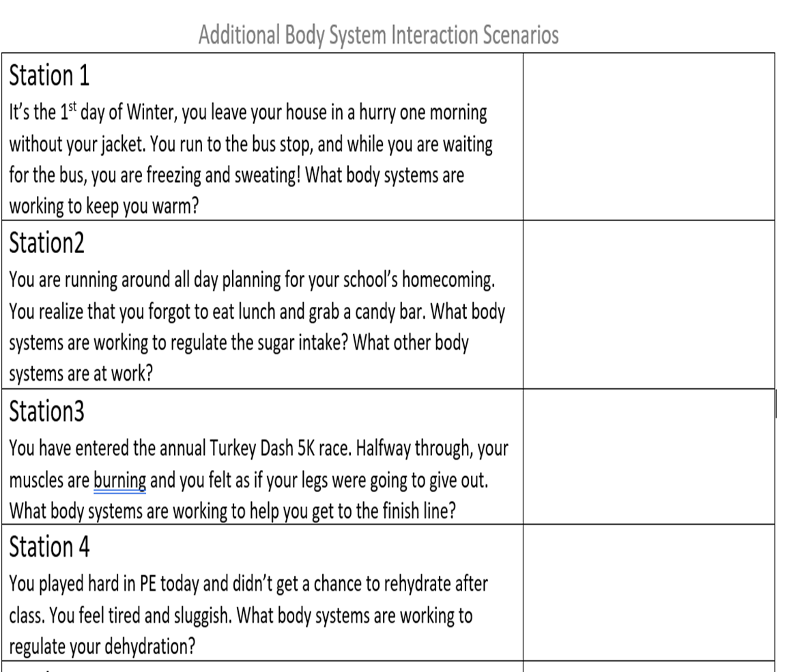
I Do - We Do - You Do
You are groups of 4,
Go to each stations scenario,
Identify the systems
Explain the Interaction
Must include at least 8 systems in each explanation
Be prepared to share your information with the class
You won’t know which one is your Station so make sure you are thorough

Slide 6
You Do
Once you have presented
Get the Ipad work with your group and complete the QUIZZIZ on my blog
Review the Study Guide on my blog
PREPARE for the UNIT Test!!!!

Slide 7
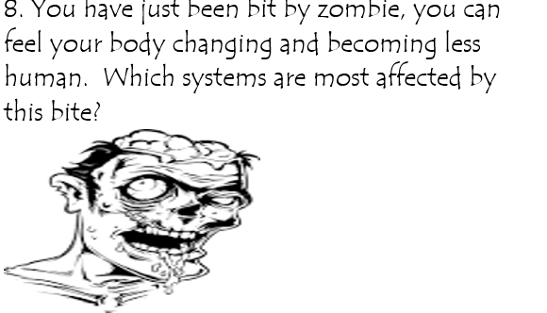
Warm Up #8
A. Endocrine and Skeletal
B. Integumentary and Nervous
C. Immune and Integumentary
D. Nervous, Immune & Integumentary
E. None of the above

Slide 8
Warm up #9
A. Cardiovascular, Excretory and Digestive
B. Nervous and Integumentary
C. Nervous, Endocrine, muscular and skeletal
D. Nervous, excretory and Integumentary
E. Others….I’ll explain

Slide 9
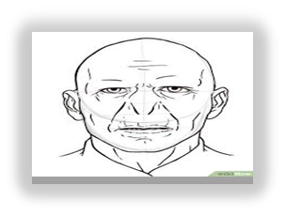
Warm up #10
10. Its late at night, you are having a little snack when suddenly appears "He Who Must Not Be Named". What body systems would be involved in your reaction?

Slide 10
What am I going to DO today?
Group Reading-Body Fueld
Human Body System Activity-Finalizing
Human Body Systems Study Guide

Slide 11
How will I show what I Know?
Complete Human Body System Activity 1-15
Folder Cover - 5 Systems symbols
Human Body Systems Study Guide

Slide 12
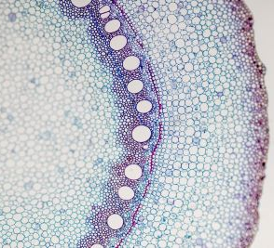
A group of similar cells that perform the same function. sue
Tissue

Slide 13
Organ
A collection of tissues that carry out a specialized function of the body

Slide 14
Organ System
group of organs that work together to perform a specific function

Slide 15
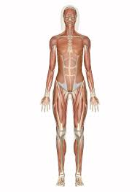
Organ system primary function is movement and flexibility
Muscular System

Slide 16
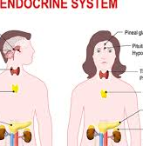
collection of glands and groups of cells that produce hormones that regulate growth, development, and homeostasis
Endocrine System

Slide 17
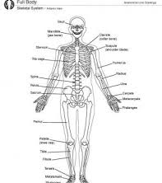
Collection of organs that take in oxygen and release carbon dioxide; includes lungs, throat, and passage ways leading to lungs
Respiratory System

Slide 18
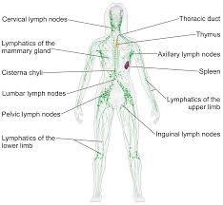
network of organs and tissues that collect fluid that leaks from blood and returns into blood vessels
Lymphatic System

Slide 19
Integumentary System
the protective covering of the body

Slide 20
Excretory System
System that is responsible for getting rid of the body's waste

Slide 21
Nervous System
structures that control the actions and reactions of the body in response to stimuli from environment

Slide 22
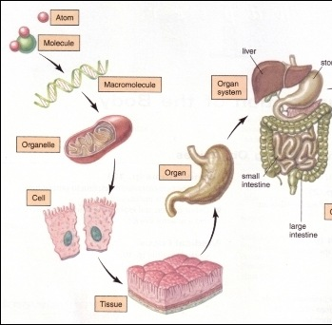
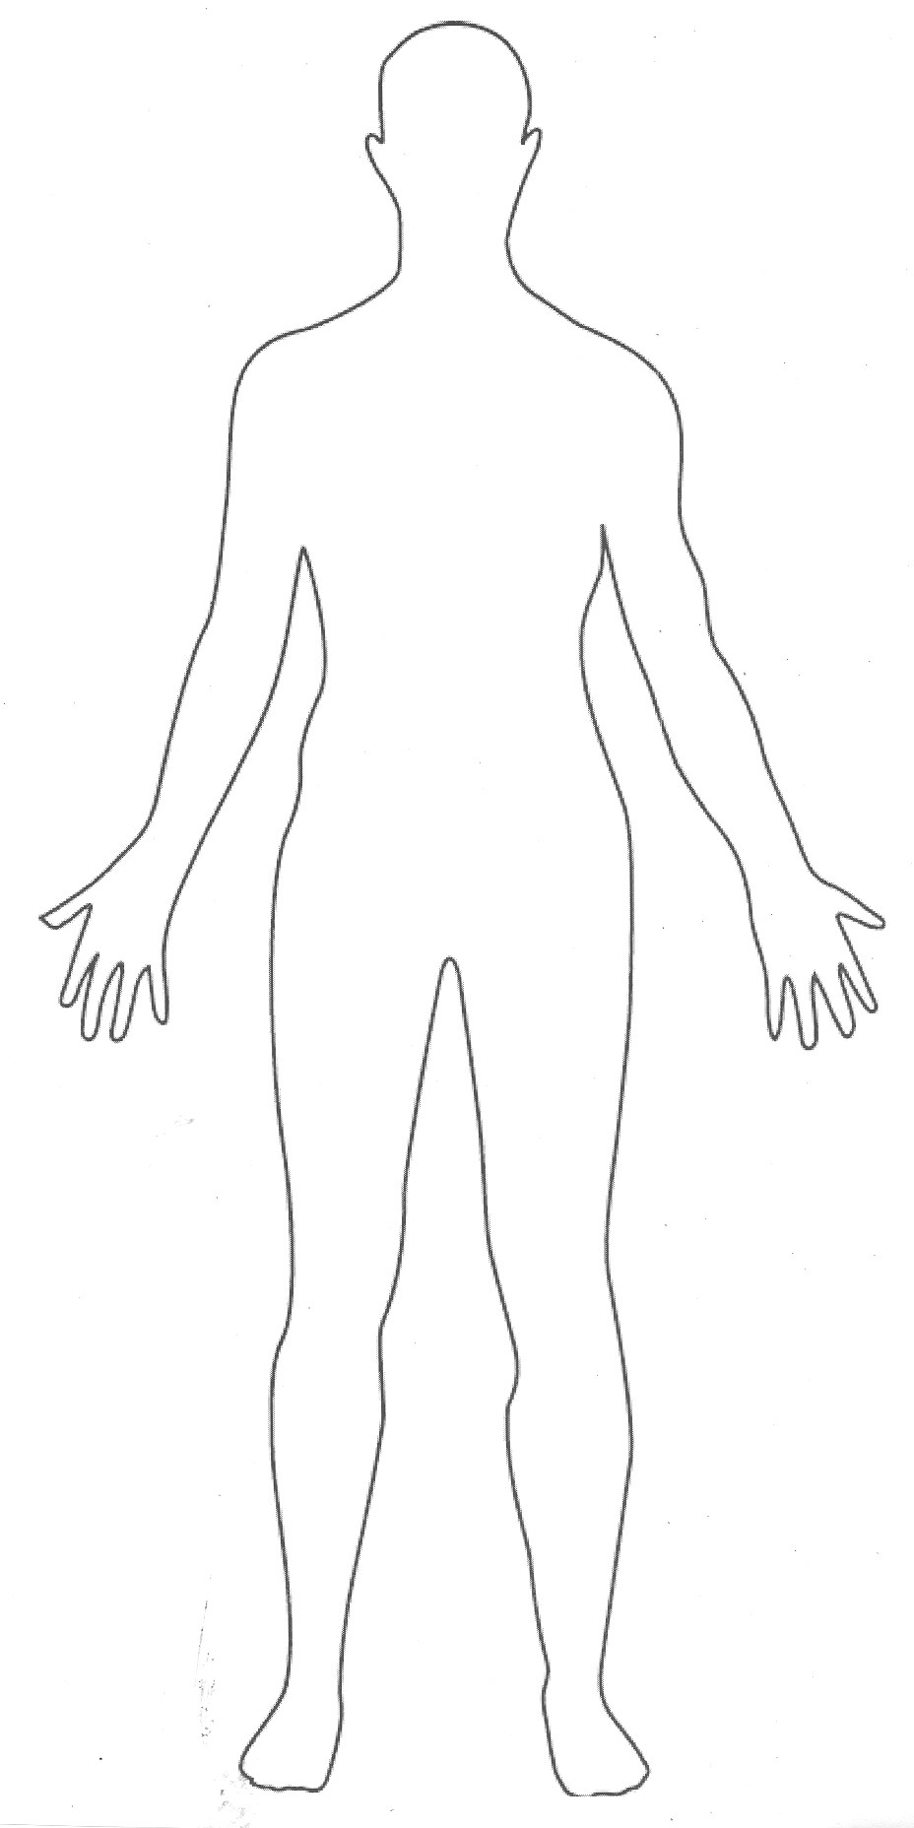
ORGANISM an entire living thing (can even be unicellular)
Humans, plants, animals, and microorganisms like bacteria

Slide 23
ATOM
MOLECULE
MACROMOLECULE
ORGANELLE
CELL
TISSUE
ORGAN
SYSTEM
ORGANISM

Slide 24
Use data to highlight both TOPIC and Skill Section

Slide 25
Will Learn
Skeletal Systems
Muscular System
Nervous System
Endocrine System
Integumentary System
Respiratory System
Cardiovascular System
Excretory System

Slide 26
Will Learn- 3 question
Skeletal Systems
Muscular System
Nervous System

Slide 27
Warm Up #4 and 5
4____________ is organ system that supports and protects the body and allows it to move.
A. Muscular System
B. Skeletal System
C. Nervous System
D. Integumentary System
5. A group of structures which function together as a unit to perform a definite job for the body
A. tissue
B. cell
C. organ
D. system

Slide 28
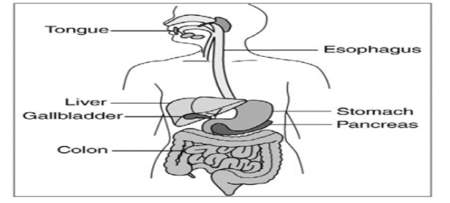
Warm Up #6
6. The diagram shows parts of the human body that work to help you eat; which term best describe the stomach?
A. cells
B. organ systems
C. organ
D. organelle

