Slide 1
Warm up
1. The diffusion of water across a selectively permeable membrane is called a______ | a. osmotic pressure. b. osmosis. c. pinocytosis. d. active transport

Slide 2
Warm up
1. The diffusion of water across a selectively permeable membrane is called a______ | a. osmotic pressure. b. osmosis. c. pinocytosis. d. active transport

Slide 3
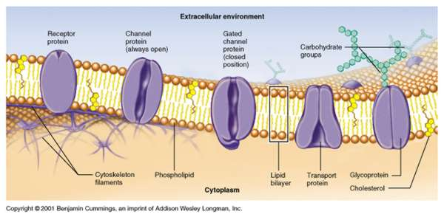
UNIT 2: CELL Transport S7L2. Obtain, evaluate, and communicate information to describe how cell structures, cells, tissues, organs, and organ systems interact to maintain the basic needs of organisms.

Slide 4
UNIT 2: CELL Transport What do you need to Know? Understand that cells take in nutrients in order to grow, divide, make needed materials, and reproduce.

Slide 5
Cell Membrane Structure
- Structure: Consists of a phospholipid bilayer
( 2 layers – bi = 2)
Fluid Mosaic Model-various parts that make up the membrane are fluid or freely moving
Hydrophilic heads-made of phosphate, like water
Hydrophobic tails-made of lipid(fat), hate water
Protein Channels-helps large molecules in and out
Protein Gates-used in active transport

Slide 6
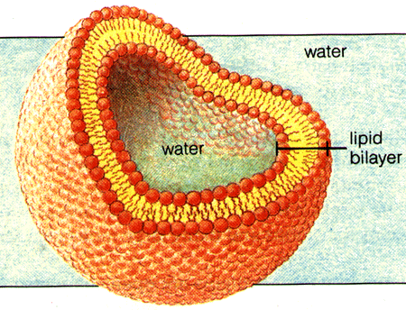
Cell Membrane
Cell Membrane a.k.a. plasma membrane
- Separates the inside of a cell from its environment.
SEMIPERMEABLE or selectively permeable-allows some things to get in, while other things stay out.

Slide 7
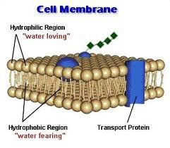
Cell Membrane Function
- Function: Controls what enters and leaves the cell in order to maintain homeostasis (internal balance a cells must maintain even if the external environment changes – This is needed for survival)

Slide 8
Cell Membrane Transport
The cell membrane helps the cell maintain homeostasis through cell transport-
Cell Transport is how substances get into and out of cells
There are 2 types of Cell Transport:
Active Transport-requires energy
Passive Transport-does NOT require energy

Slide 9
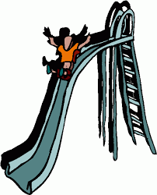
Cellular Transport
Passive Transport – energy IS NOT required to move
molecules across the cell membrane.
Molecules move from an area of HIGH concentration to an area of LOW concentration WITH the concentration gradient.
**THINK HIGH TO LOW, GO WITH THE FLOW!!

Slide 10
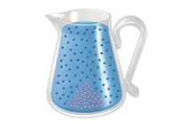
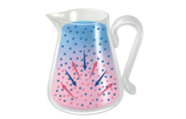
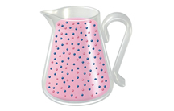
Passive Transport
1) Diffusion – SMALL molecules, like oxygen, can pass right through the cell membrane by slipping between the phospholipids
Dynamic Equilibrium
Diffusion
Initial Conditions
Low
High
High
Low

Slide 11
Cellular Transport
Diffusion is controlled by
Temperature
Pressure
Concentration
Dynamic Equilibrium
When diffusion of material into the cell equals diffusion of material out of the cell

Slide 12
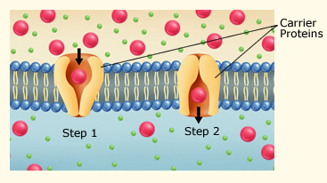
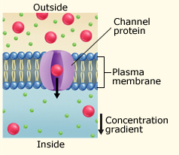
Passive Transport
2) Facilitated Diffusion – LARGE molecules, like sugar, must pass through the protein channels in the bilayer

Slide 13
Passive Transport
3) Osmosis
Diffusion of water across a selectively permeable membrane
Three Types of Solutions
A. Isotonic
B. Hypotonic
C. Hypertonic

Slide 14
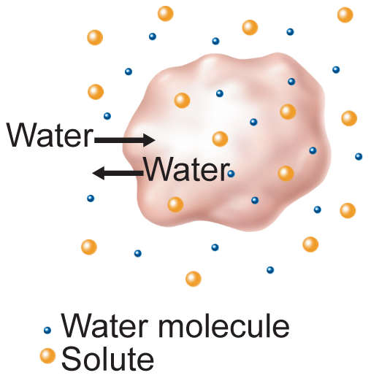
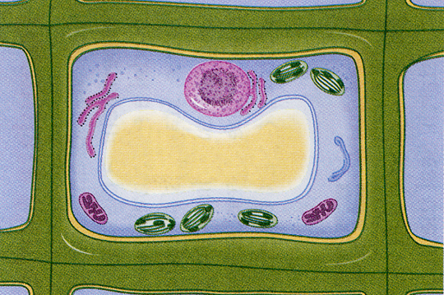
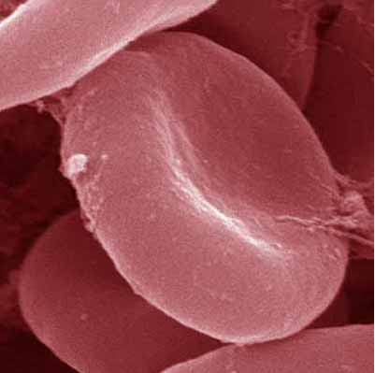
A. Isotonic Solution
Water and dissolved substances diffuse into and out of the cell at the same rate.
Plant Cell
Blood Cell
11,397x

Slide 15
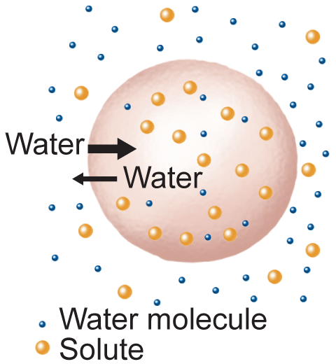
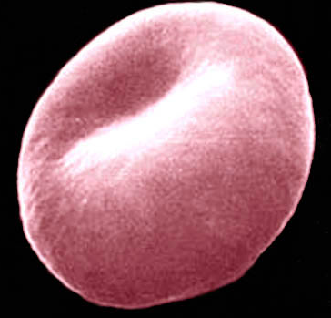
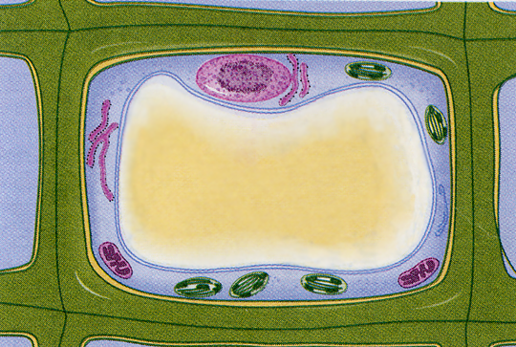
Cellular Transport
B. Hypotonic Solution
Solute concentration is higher inside the cell.
Water diffuses into the cell.
BLOWS UP the cell.
Plant Cell
Blood Cell
13,000x

Slide 16
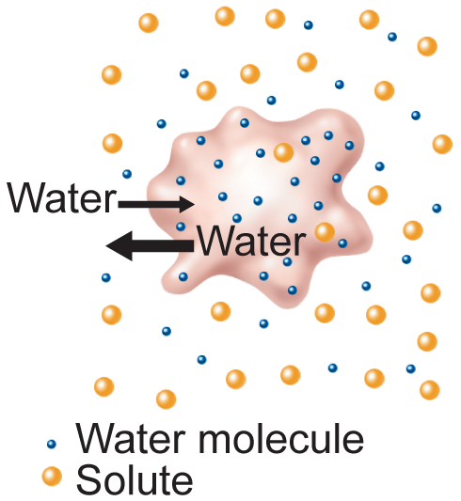
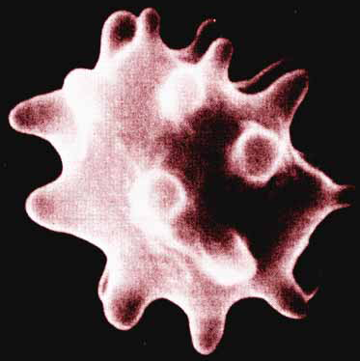
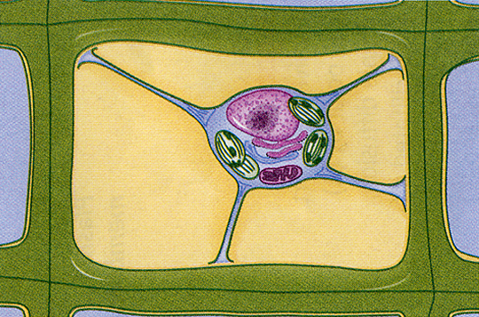
Cellular Transport
C. Hypertonic Solution
Solute concentration is higher outside the cell.
Water diffuses out of the cell.
SHRINKS the cell.
Blood Cell
Plant Cell
13,000x

Slide 17
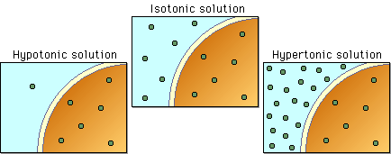
Solutions

Slide 18
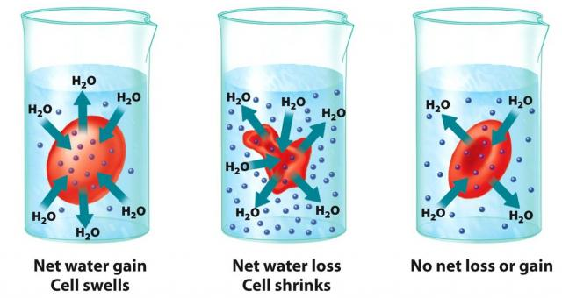

Slide 19
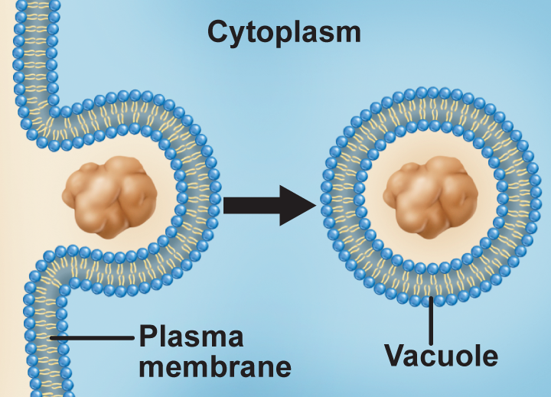
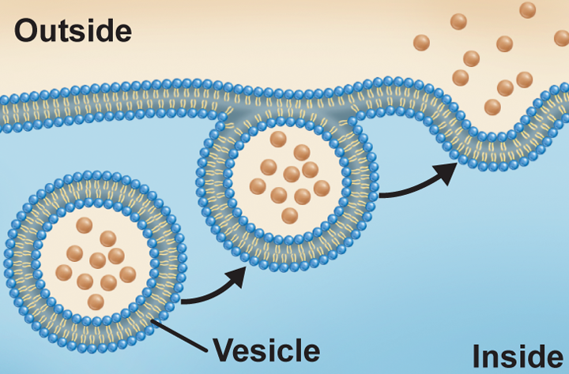
Active Transport
2) Active Transport – energy IS required to move molecules across the cell membrane. Molecules move from an area of LOW concentration to and area of HIGH concentration AGAINST the concentration gradient.

Slide 20
Types of Active Transport
1) Protein Pumps – Molecules are “pumped” through the cell membrane through protein gates
2) Endocytosis – mass is surrounded by a cell and is taken into the cell
3) Exocytosis – mass is removed from the cytoplasm and is “expelled” out of the cell into its environment
https://www.youtube.com/watch?v=mv6Ehv06mXY
https://www.youtube.com/watch?v=pvOz4V699gk

Slide 21
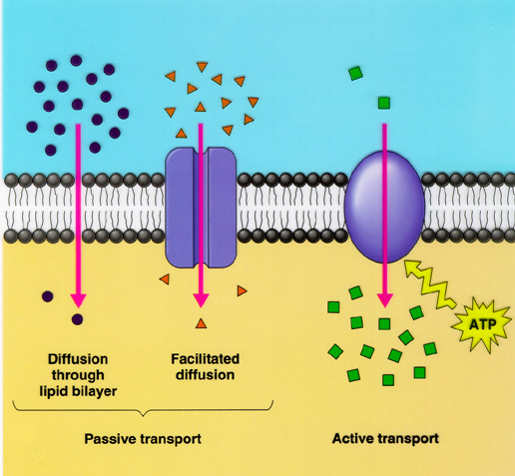
Cellular Transport

